Slide 1
Which features of postural sway are effective in distinguishing Parkinson’s patients from controls? - An experimental investigation
Wenbo Geª, Christian Lueck^{c,d}, Deborah Apthorp^{a,b}, Hanna Suominen^{a,e}
ªSchool of Computing, Australian National University, Canberra, 2600, Australia
^{b}School of Psychology, University of New England, Armidale, 2350, Australia
^{c}Department of Neurology, Canberra Hospital, Canberra, 2605, Australia
^{d}ANU Medical School, Australian National University, Canberra, 2600, Australia
^{e}Department of Computing, University of Turku, Finland

Slide 2
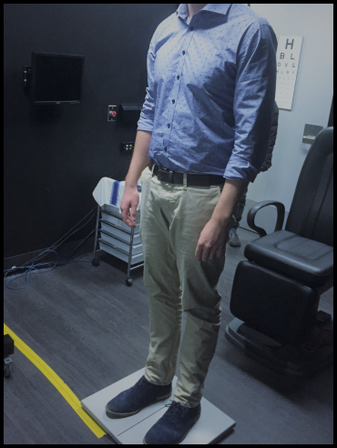
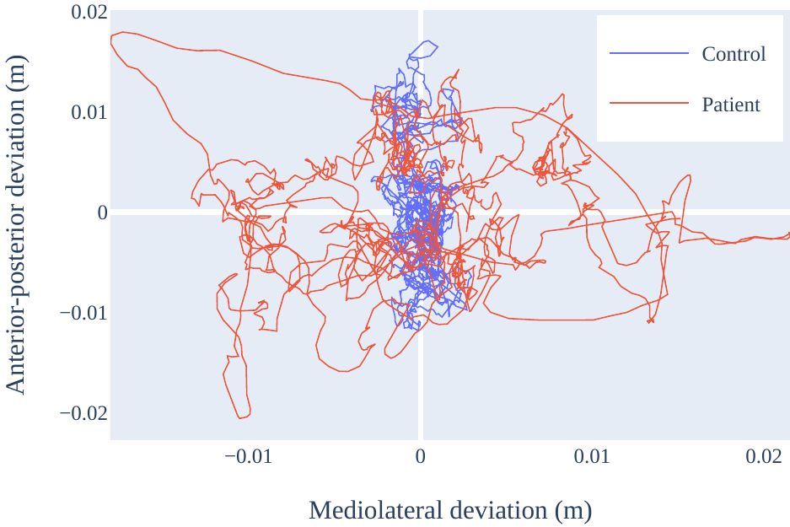
Introduction
Parkinson’s disease (PD)
2nd most prevalent neurological disease¹
Can impair quality of life, and associated with increased mortality rates²
Late diagnosis and misdiagnosis often reported^{3, 4}
Disease severity rating (UPDRS) suffers from inter-rater variability⁵
An accurate and quantifiable marker could help
…such as postural sway
Measured as the Centre of Pressure (CoP) over time
Requires visual, vestibular, and somatosensory inputs⁶
Research suggests PD affects postural sway⁷

Slide 3
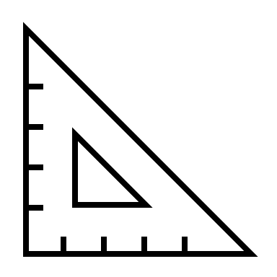



Introduction
Postural sway features
Can be used to distinguish PD vs controls
Many papers have featurised postural sway
A systematic literature review in 2020⁸ analysed these papers and identified:
129 features
Also determined, using effect size:
What conditions made them more effective
Systemic issues, and how they can be resolved

Slide 4
Introduction
Aims
To experimentally investigate the claims made in the review:
If sampling frequency has a meaningful impact on effectiveness
If visual state has a meaningful impact on effectiveness
If machine learning can address the issues, that is:
the lack of using multiple features
the lack of out-of-sample testing

Slide 5
 | PD group | Control group
Number of participants | 24 | 15
Number of males (%) | 16 (67%) | 5 (33%)
Mean age (SD) | 67.0 (9.06) | 72.4 (10.56)
Mean UPDRS (SD) | 25.5 (13.08) | n/a
Mean years diagnosed (SD) | 6.98 (5.20) | n/a
Methods
Data
Retrieved from The Canberra Hospital Ethics was granted by the ACT Health Human Research Ethics Committee (ETH.4.16.060) and the ANU Human Ethics Protocol (2018/108)
With a Bertec force plate
Sampled at 1,000 Hz
Quiet upright stance, without shoes, feet comfortable distance apart
For at least 90 seconds
With separate recordings for eyes open (EO) and eyes closed (EC)
Patients were ON medication

Slide 6

Methods
Effect of sampling rate
Down-sampled to frequency 𝑓 = [10, 20, 40, 100] Hz by:
Anti-aliasing (low pass 8th order Chebyshev type 1 filter at 𝑓/2 Hz)
Subsampling to 𝑓 Hz
All features calculated for each participant
Effect size for each feature was calculated
 | PD_1 | C_1 | …
A_EO | 0.80 | 0.62
A_EC | 0.42 | 0.38
B_EO | 2.41 | 3.84
B_EC | 5.51 | 7.51
…
H | 0.05 | 0.12
…
 | 10 Hz
A_EO | 0.60
A_EC | 1.01
B_EO | 0.85
B_EC | 0.3
…
H | 0.6
…
$$\frac{{\overline{x}}_{PD}−{\overline{x}}_{HC}}{SD^{∗}}=g$$

Slide 7


Methods
Effect of sampling rate
 | 10 Hz | 20 Hz | 40 Hz | 100 Hz
A_EO | 0.60 | 0.65 | 0.55 | 0.5
A_EC | 1.01 | 0.99 | 0.98 | 0.66
B_EO | 0.85 | 0.81 | 0.55 | 0.6
B_EC | 0.3 | 0.2 | 0.33 | 0.27
…
H | 0.6 | 0.45 | 0.55 | 0.66
…
 | 10 Hz | 20 Hz | 40 Hz | 100 Hz
A_EO | 0.92 | 1.00 | 0.85 | 0.77
A_EC | 1.00 | 0.98 | 0.97 | 0.65
B_EO | 1.00 | 0.95 | 0.65 | 0.71
B_EC | 0.91 | 0.61 | 1.00 | 0.82
…
H | 0.91 | 0.68 | 0.83 | 1.00
…
Best f
1.00
1.00
1.00
1.00
1.00
/= max across $f$
Distributions compared to ideal using Wasserstein metric¹³
Summarised with a kernel density estimate¹⁴ and visually compared
$$W(u,v)$$

Slide 8
Methods
Effect of visual state
 | PD_1 | C_1 | …
A_EO | 0.80 | 0.62
A_EC | 0.42 | 0.38
B_EO | 2.41 | 3.84
B_EC | 5.51 | 7.51
…
H | 0.05 | 0.12
…
 | EO | EC
A | 0.60 | 0.65
B | 1.01 | 0.99
C | 0.85 | 0.81
…
 | EO | EC
A | 0.92 | 1.00
B | 1.00 | 0.98
C | 1.00 | 0.95
…
$$\frac{{\overline{x}}_{PD}−{\overline{x}}_{HC}}{SD^{∗}}=g$$
/= max visual state
Distributions compared to ideal using Wasserstein metric¹³
Summarised with a kernel density estimate¹⁴ and visually compared

Slide 9
1
Methods
Machine learning for effectiveness
PD_1 | Control_4
PD_2 | Control_17
PD_3 | Control_2
PD_4 | Control_33
PD_5 | Control_1
PD_6 | Control_25
… | …
2
3
For each feature:
Pair the participants
Perform 5-fold cross validation
Using an ensemble model (support vector machine, random forests, and logistic regression)
Repeat 10 times
Average AUROC across 10 repetitions
Treated the same as effect size previously outlined
4
5

Slide 10
Methods
Machine learning for effectiveness, multiple features
Can expose the model to all features
Can also expose model to selected features. We try 4 approaches:
Minimum redundancy: Choose features that are least similar to each other
Maximum relevance: Choose features that are most similar to target variable
Wrapper: Train a model on the task, then infer feature importance from the model
Dimensionality reduction: With Principle Component Analysis (not feature selection, but similar in intent)

Slide 11
Methods
Machine learning for effectiveness, statistical significance
Bayesian equivalence testing for statistical significance¹⁵
Performed on all machine learning results
To determine if performance was worse, equivalent, or better (with a % confidence)

Slide 12
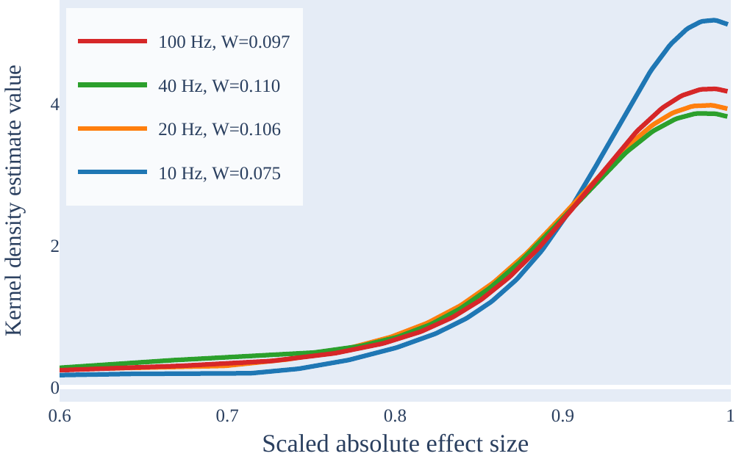
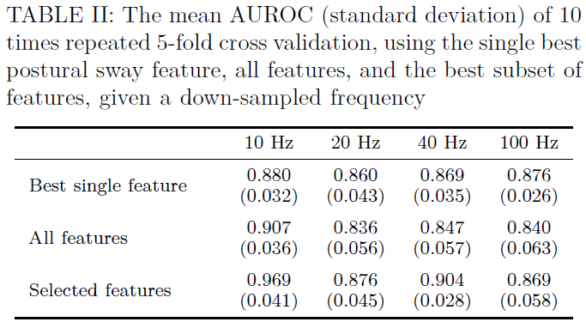
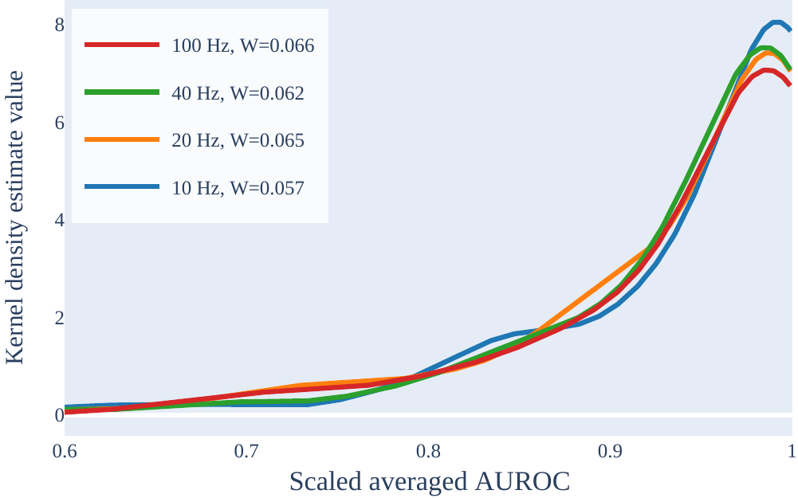
Results
Effect of sampling rate
10 Hz has the best effectiveness
Selected features almost always better
Nothing can be said at 90% confidence

Slide 13
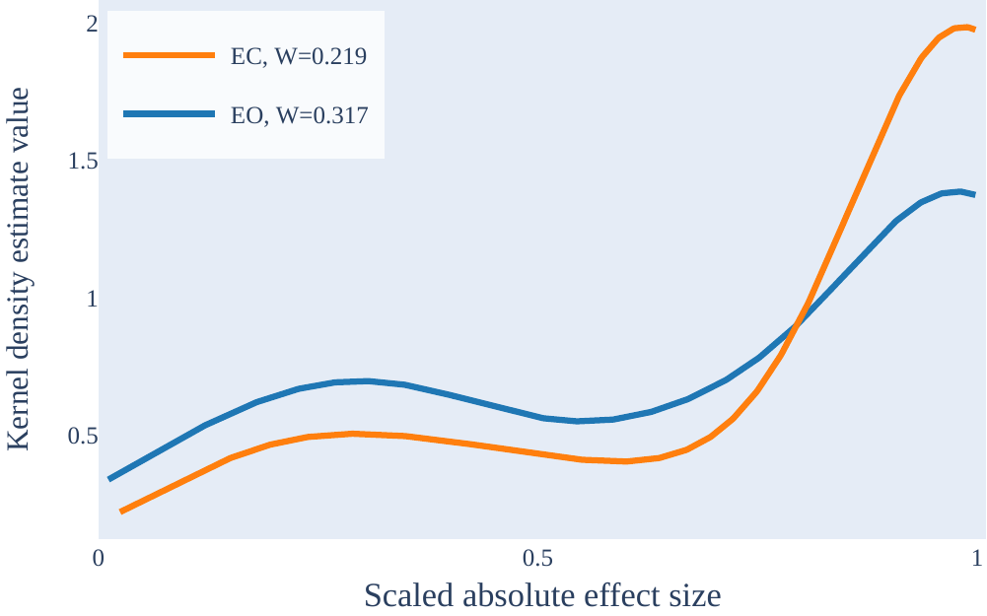
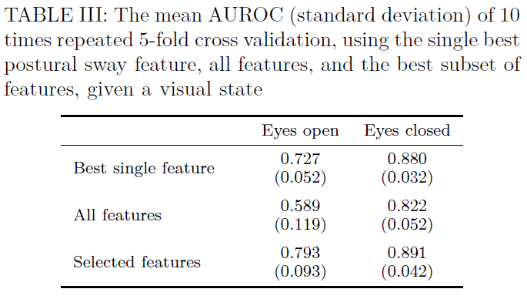
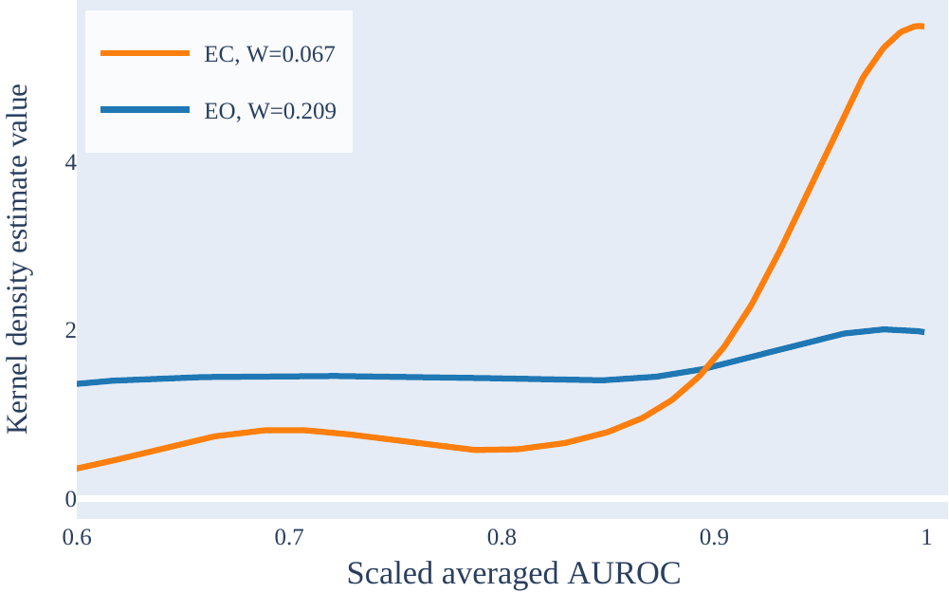
Results
Effect of visual state
EC best visual state
Selected features always better
At 90% confidence, we can say that “all features” with EC is more effective than “all features” with EO
Using both visual states was always better than only EC

Slide 14
Discussions
Aims:
If sampling frequency has a meaningful impact on effectiveness
It does, 10 Hz was best. Not confident
If visual state has a meaningful impact on effectiveness
It does, EC was better, but both was best. Not confident
If machine learning can address the issues
It can address the issues (out-of-sample testing and using multiple features)
Can improve the effectiveness
Likely to play an important role in the future of postural sway quantification

Slide 15
Thank you
Contact Us
Wenbo Ge
School of Computing, Australian National University
T +61 4 23084764
E wenbo.ge@anu.edu.au

Slide 16
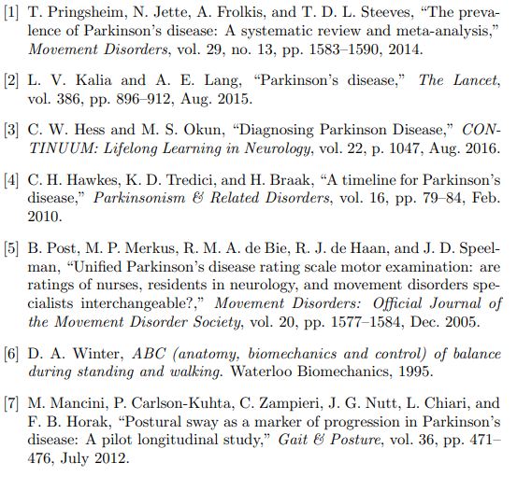
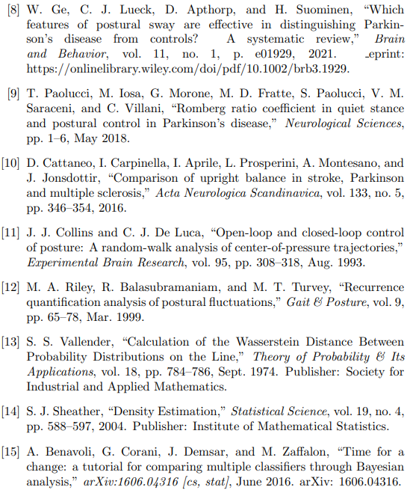
Bibliography
The online repository for the experiments outlined can be found at: https://github.com/Wenbo-G/pd-sway-analysis

